Slide 1
Storage, ISS, RAID, SSD

Slide 2
Part 1 - Introduction to Information Storage
Upon completion of this module, you should be able to:
Describe digital data, types of digital data, and information
Describe data center and its key characteristics
Describe key data center management processes
Describe the evolution of computing platforms
Notes:
This module focuses on digital data, the types of digital data, and information. This module also focuses on data center and its key characteristics. Further this module focuses on the key data center management processes. Finally, this module focuses on the evolution of computing platforms.

Slide 3
The Growth of the Digital Universe
The digital universe is created and defined by software
Digital data is continuously generated, collected, stored, and analyzed through software
The digital universe generates approximately 4.4 trillion GB of data annually
Proliferation of IT, Internet usage, social media, and smart devices adds to data growth
The Internet of Things (IoT) is also adding to data growth
IoT is made up of Internet-connected equipment and sensors
Notes:
We live in a digital universe – a world that is created and defined by software. A massive amount of digital data is continuously generated, collected, stored, and analyzed through software in the digital universe. According to the 2014 Digital Universe Study conducted by International Data Corporation (IDC), it is estimated that the digital universe produces approximately 4.4 trillion gigabytes (GB) of data annually, which is doubling every two years. By these estimates, it is projected that by the year 2020, the digital universe will expand to 44 trillion GB of data. The data in the digital universe comes from diverse sources, including individuals living and working online, organizations employing information technology (IT) to run their businesses, and from a variety of “smart” electronic devices connected to the Internet.
In organizations, the volume and importance of information for business operations continue to grow at astounding rates. Individuals constantly generate and consume information through numerous activities, such as web searches, e-mails, uploading and downloading content and sharing media files. The rapid proliferation of online social networking and Internet-enabled smartphones and tablets has also contributed significantly to the growth of the digital universe.
The advent of the Internet of Things (IoT) is also gradually adding to the growth of the digital universe. The IoT is a technology trend wherein “smart” devices with embedded electronics, software, and sensors exchange data with other devices over the Internet. Examples of such devices are wearable gadgets – smartwatches and fitness activity trackers; electronic sensors – temperature sensors and heart monitoring implants; and household appliances – televisions, thermostats, and lighting. The IoT has vast applications and is driving the development of several innovative technology solutions. Some application areas include weather monitoring – remote monitoring and analysis of temperature and atmospheric conditions; healthcare – health monitoring devices can enable doctors to remotely monitor patients and be notified in case of emergencies; and infrastructure management – technicians can remotely monitor equipment and proactively schedule repair activities for maintenance crews.

Slide 4
Why Information Storage and Management?
Organizations are dependent on continuous and reliable access to information
Organizations seek to effectively store, protect, process, manage, and leverage information
Organizations are increasingly implementing intelligent storage solutions
To efficiently store and manage information
To gain competitive advantage
To derive new business opportunities
Notes:
Organizations have become increasingly information-dependent in the twenty-first century, and information must be available whenever and wherever it is required. It is critical for users and applications to have continuous, fast, reliable, and secure access to information for business operations to run as required. Some examples of such organizations and processes include banking and financial institutions, government departments, online retailers, airline reservations, billing and transaction processing, social networks, stock trading, scientific research, and healthcare.
It is essential for organizations to store, protect, process, and manage information in an efficient and cost-effective manner. Legal, regulatory, and contractual obligations regarding the availability, retention, and protection of data further add to the challenges of storing and managing information.
Organizations also face newer challenges in the form of requirement to extract value from the information generated in the digital universe. Information can be leveraged to identify opportunities to transform and enhance businesses and gain a competitive edge. For example, an online retailer may need to identify the preferred product types and brands of customers by analyzing their search, browsing, and purchase patterns. The retailer can then maintain a sufficient inventory of popular products, and also advertise relevant products to the existing and potential customers. Furthermore, the IoT is expected to lead to new consumer and business behavior in the coming years creating new business opportunities.
To meet all these requirements and more, organizations are increasingly undertaking digital transformation initiatives to implement intelligent storage solutions. These solutions not only enable efficient and optimized storage and management of information, but also enable extraction of value from information to derive new business opportunities, gain a competitive advantage, and create new sources of revenue.

Slide 5







What is Digital Data?
Digital Data
A collection of facts that is transmitted and stored in electronic form, and processed through software.
Video
Laptop
Text
10101011010
11101011011
11101110100
00110101110
10011101001
11100100010
10101010101
01110111011
10111011101
Desktop
Photos
Internal or
External Storage
Digital Data
Tablet and Mobile
Notes:
A generic definition of data is that it is a collection of facts, typically collected for the purpose of analysis or reference. Data can exist in a variety of forms such as facts stored in a person's mind, photographs and drawings, alphanumeric text and images in a book, a bank ledger, and tabled results of a scientific survey. Originally, data is the plural form of “datum”. However, data is now generally treated as a singular or mass noun representing a collection of facts and figures. This is especially true when referring to digital data.
In computing, digital data is a collection of facts that is transmitted and stored in electronic form, and processed through software. Digital data is generated by various devices, such as desktops, laptops, tablets, mobile phones, and electronic sensors. It is stored as strings of binary values (0s and 1s) on a storage medium that is either internal or external to the devices generating or accessing the data. The storage devices may be of different types, such as magnetic, optical, or solid state storage devices. Examples of digital data are electronic documents, text files, e-mails, e-books, digital images, digital audio, and digital video.

Slide 6
Types of Digital Data
Data that has no inherent structure and is usually stored as different types of files.
E.g. Text documents, PDFs, images, and videos
Unstructured
Textual data with erratic formats that can be formatted with effort and software tools
E.g. Clickstream data
Quasi-Structured
Increasing Growth
Textual data files with an apparent pattern, enabling analysis
E.g. Spreadsheets and XML files
Semi-Structured
Data having a defined data model, format, structure
E.g. Database
Structured
Notes:
Based on how it is stored and managed, digital data can be broadly classified as either structured data or unstructured data. Structured data is organized in fixed fields within a record or file. For data to be structured, a data model is required. A data model specifies the format for organizing data, and also specifies how different data elements are related to each other. For example, in a relational database, data is organized in rows and columns within named tables. Semi-structured data does not have a formal data model but has an apparent, self-describing pattern and structure that enable its analysis. Examples of semi-structured data include spreadsheets that have a row and column structure, and XML files that are defined by an XML schema. Quasi-structured data consists of textual data with erratic data formats, and can be formatted with effort, software tools, and time. An example of quasi-structured data is a “clickstream” or “clickpath” that includes data about which webpages a user visited and in what order – which is the result of the successive mouse clicks the user made. A clickstream shows when a user entered a website, the pages viewed, the time spent on each page, and when the user exited. Unstructured data does not have a data model and is not organized in any particular format. Some examples of unstructured data include text documents, PDF files, e-mails, presentations, images, and videos.
As indicated by the figure on the slide, the majority, which is more than 90 percent, of the data generated in the digital universe today is non-structured data (semi-, quasi-, and unstructured). Although the figure shows four different and separate types of data, in reality a mixture of these is typically generated. For instance, in a call center for customer support of a software product, a classic relational database management system (RDBMS) may store call logs with structured data such as date/time stamps, machine types, and problem type entered by the support desk person. In addition, there may be unstructured or semi-structured data, such as an e-mail ticket of the problem, call log information, or the actual call recording.

Slide 7
What is Information?
Information
Processed data that is presented in a specific context to enable useful interpretation and decision-making.
Example: Annual sales data processed into a sales report
Enables calculation of the average sales for a product and the comparison of actual sales to projected sales
New architectures and technologies have emerged for extracting information from non-structured data
Notes:
The terms “data” and “information” are closely related and it is common for the two to be used interchangeably. However, it is important to understand the difference between the two. Data, by itself, is simply a collection of facts that needs to be processed for it to be useful. For example a set of annual sales figures of an organization is data. When data is processed and presented in a specific context it can be interpreted in a useful manner. This processed and organized data is called information. For example, when the annual sales data is processed into a sales report, it provides useful information, such as the average sales for a product (indicating product demand and popularity), and a comparison of the actual sales to the projected sales. Information thus creates knowledge and enables decision-making.
As discussed previously, processing and analyzing data is vital to any organization. It enables organizations to derive value from data, and create intelligence to enable decision-making and organizational effectiveness. It is easier to process structured data due to its organized form. On the other hand, processing non-structured data and extracting information from it using traditional applications is difficult, time-consuming, and requires considerable resources. New architectures, technologies, and techniques (described in Module 2, ‘Third Platform Technologies’) have emerged that enable storing, managing, analyzing, and deriving value from unstructured data coming from numerous sources.

Slide 8
Information Storage
Information is stored on storage devices on non-volatile media
Types of storage devices:
Magnetic storage devices: Hard disk drive and magnetic tape
Optical storage devices: Blu-ray disc, DVD, and CD
Flash-based storage devices: Solid state drive, memory card, and USB thumb drive
Storage devices are assembled within a storage system or “array”
Provides high capacity, scalability, performance, reliability, and security
Storage systems along with other IT infrastructure are housed in a data center
Notes:
In a computing environment, storage devices (or simply “storage”) are devices consisting of non-volatile recording media on which information can be persistently stored. Storage may be internal (for example, internal hard drive), removable (for example, memory cards), or external (for example, magnetic tape drive) to a compute system. Based on the nature of the storage media used, storage devices can be broadly classified as given below:
Magnetic storage devices: For example, hard disk drive and magnetic tape drive.
Optical storage devices: For example, Blu-ray, DVD, and CD.
Flash-based storage devices: For example, solid state drive (SSD), memory card, and USB thumb drive (or pen drive).
Storage is a core component in an organization’s IT infrastructure. Various factors such as the media, architecture, capacity, addressing, reliability, and performance influence the choice and use of storage devices in an enterprise environment. For example, disk drives and SSDs are used for storing business-critical information that needs to be continuously accessible to applications; whereas, magnetic tapes and optical storage are typically used for backing up and archiving data. The different types of storage devices are covered in Module 3, ‘Data Center Environment’.
In enterprise environments, information is typically stored on storage systems (or storage “arrays”). A storage system is a hardware component that contains a group of homogeneous/heterogeneous storage devices assembled within a cabinet. These enterprise-class storage systems are designed for high capacity, scalability, performance, reliability, and security to meet business requirements. The compute systems that run business applications are provided storage capacity from storage systems. Storage systems are covered in Module 4, ‘Intelligent Storage Systems (ISS)’. Organizations typically house their IT infrastructure, including compute systems, storage systems, and network equipment within a data center.

Slide 9
What is a Data Center?
Data Center
A facility that houses IT equipment including compute, storage, and network components, and other supporting infrastructure for providing centralized data-processing capabilities.
A data center comprises:
Facility: The building and floor space where the data center is constructed
IT equipment: Compute, storage, and network equipment
Support infrastructure: Power supply, fire detection, HVAC, and security systems
Notes:
A data center is a dedicated facility where an organization houses, operates, and maintains back-end IT infrastructure including compute systems, storage systems, and network equipment along with other supporting infrastructure. A data center centralizes an organization’s IT equipment and data-processing operations, and is vital for carrying out business operations.
A data center typically comprises the following:
Facility: It is the building and floor space where the data center is constructed. It typically has a raised floor with ducts underneath holding power and network cables.
IT equipment: It includes equipment such as compute systems, storage systems, network equipment and cables, and cabinets for housing the IT equipment.
Support infrastructure: It includes all the equipment necessary to securely sustain the functioning of the data center. Some key support equipment are power equipment including uninterruptible power sources, and power generators; environmental control equipment including fire and water detection systems, heating, ventilation, and air conditioning (HVAC) systems; and security systems including biometrics, keycard, and video surveillance systems.
An organization may build a data center to provide open access to applications over the Internet, or for privately executing business applications within its operational environment. A data center may be constructed in-house and located in an organization’s own facility, or it may be outsourced, with equipment being located at a third-party site. Large organizations often maintain multiple data centers to distribute data-processing workloads and for disaster recovery.
Organizations are increasingly focusing on energy-efficient technologies and efficient management practices to reduce the energy consumption of data centers and lessen the impact on the environment. Such data centers are called as “green data centers”.

Slide 10
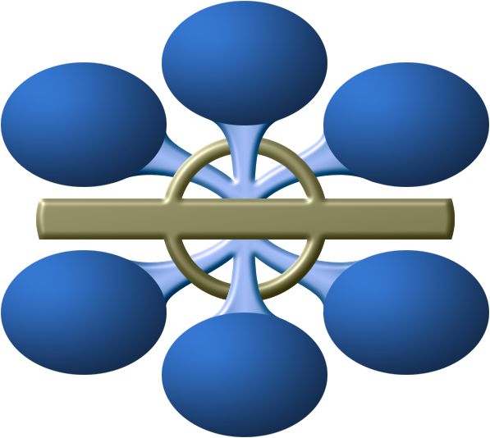
Key Characteristics of a Data Center
Availability
Data Integrity
Security
Manageability
Performance
Capacity
Scalability
Notes:
Data centers are designed and built to fulfill the key characteristics shown in the figure on the slide. Although the characteristics are applicable to almost all data center components, the discussion here primarily focuses on storage systems.
Availability: Availability of information as and when required should be ensured. Unavailability of information can severely affect business operations, lead to substantial financial losses, and damage the reputation of an organization.
Security: Policies and procedures should be established, and control measures should be implemented to prevent unauthorized access to and alteration of information.
Capacity: Data center operations require adequate resources to efficiently store and process large and increasing amounts of data. When capacity requirements increase, additional capacity should be provided either without interrupting the availability or with minimal disruption. Capacity may be managed by adding new resources or by reallocating existing resources.
Scalability: Organizations may need to deploy additional resources such as compute systems, new applications, and databases to meet the growing requirements. Data center resources should scale to meet the changing requirements, without interrupting business operations.
Performance: Data center components should provide optimal performance based on the required service levels.
Data integrity: Data integrity refers to mechanisms, such as error correction codes or parity bits, which ensure that data is stored and retrieved exactly as it was received.
Manageability: A data center should provide easy, flexible, and integrated management of all its components. Efficient manageability can be achieved through automation for reducing manual intervention in common, repeatable tasks.

Slide 11
Key Data Center Management Processes
Management Process | Description
Monitoring | Continuously gathering information on data center resources
Reporting | Presenting the details on resource performance, capacity, and utilization
Provisioning | Configuring and allocating resources to meet the capacity, availability, performance, and security requirements
Planning | Estimating the amount of resources required to support business operations
Maintenance | Ensuring the proper functioning of resources and resolving incidents
Notes:
The activities carried out to ensure the efficient functioning of a data center can be broadly categorized under the following key management processes:
Monitoring: It is a continuous process of gathering information on various resources in the data center. The process involves monitoring parameters such as configuration, availability, capacity, performance, and security of resources.
Reporting: It is a process of collating and presenting the monitored parameters such as resource performance, capacity, and utilization of resources. Reporting enables data center managers to analyze and improve the utilization of data center resources and identify problems. It also helps in establishing business justifications and chargeback of costs associated with data center operations.
Provisioning: It is the process of configuring and allocating the resources that are required to carry out business operations. For example, compute systems are provisioned to run applications and storage capacity is provisioned to a compute system. Provisioning primarily includes resource management activities to meet capacity, availability, performance, and security requirements.
Planning: It is a process of estimating the amount of IT resources required to support business operations and meet the changing resource requirements. Planning leverages the data collected during monitoring and enables improving the overall utilization and performance of resources. It also enables estimation of future resource requirements. Data center managers also determine the impact of incidents and devise contingency plans to resolve them.
Maintenance: It is a set of standard repeatable activities for operating the data center. It involves ensuring the proper functioning of resources and resolving incidents such as malfunctions, outages, and equipment loss. It also involves handling identified problems or issues within the data center and incorporating changes to prevent future problem occurrence.

Slide 12



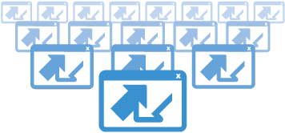

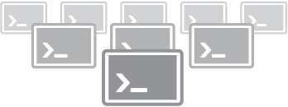
Evolution of Computing Platforms
PLATFORM 3
Cloud Big Data Mobile Social Mobile Devices
BILLIONS OF USERS
MILLIONS OF APPS
PLATFORM 2
LAN/Internet Client/Server PC
HUNDREDS OF MILLIONS OF USERS
TENS OF THOUSANDS OF APPS
PLATFORM 1
Mainframe, Mini Computer
Terminals
MILLIONS OF USERS
THOUSANDS OF APPS
Notes:
In general, the term “platform” refers to hardware and software that are associated with a particular computing architecture deployed in a data center. Computing platforms evolve and grow with advances and changes in technology. The figure on the slide displays the three computing platforms of IT growth as specified by IDC. The first platform (or Platform 1) dates back to the dawn of computing and was primarily based on mainframes and terminals. The second platform (or Platform 2) emerged with the birth of the personal computer (PC) in the 1980s and was defined by the client-server model, Ethernet, RDBMSs, and web applications. The third platform (or Platform 3) of today comprises cloud, Big Data, mobile, and social technologies.
Each computing platform is defined not so much by the comprising technologies but by the scale of users and the scope of applications the technologies enable. The first platform supported millions of users, with applications and solutions in the low thousands. The second platform supported hundreds of millions of users and tens of thousands of applications. The third platform is already supporting a user base of billions and has millions of applications and solutions. This is evident from the fact that over 2.4 billion people (~36 percent of the world's population) are currently connected to the Internet (more than half of them through mobile devices), and that there are over one million applications available for iOS and Android devices alone.

Slide 13
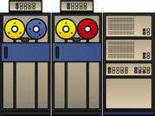

First Platform
Based on mainframes
Applications and databases hosted centrally
Users connect to mainframes through terminals
Challenges with mainframes
Substantial CAPEX and OPEX
High acquisition costs
Considerable floor space and energy requirements
Data Center
Mainframe
(Applications
and data)
Terminals
Notes:
Mainframes are compute systems with very large processing power, memory, and storage capacity and are primarily used for centrally hosting mission-critical applications and databases in an organization’s data center. Multiple users simultaneously connect to mainframes through less-powerful devices, such as workstations or terminals. All processing is performed on the mainframe, while the terminals only provide an interface to use the applications and view results. Although mainframes offer high reliability and security, there are several cost concerns associated with them. Mainframes have high acquisition costs, and considerable floor space and energy requirements. Deploying mainframes in a data center may involve substantial capital expense (CAPEX) and operating expense (OPEX). Historically, large organizations such as banks, insurance agencies, and government departments have used mainframes to run their business operations.

Slide 14





Second Platform
Based on client-server model
Distributed application architecture
Servers receive and process requests for resources from clients
Users connect through a client program or a web interface
Challenges with client-server model
Creation of IT silos
Hardware and software maintenance overhead
Scalability to meet the growth of users and workloads
Data Center
Web Server
Application Server
Database Server
Request
LAN/WAN
Response
Clients
(Client software or web browser)
Notes:
The client-server model uses a distributed application architecture, in which a compute system called “server” runs a program that provides services over a network to other programs running on various end-point devices called “clients”. Server programs receive requests for resources from client programs and in response to the requests, the clients receive access to resources, such as e-mail applications, business applications, web applications, databases, files, and printers. Client devices can be desktops, laptops, and mobile devices. Clients typically communicate with servers over a LAN or WAN, with users making use of either a client application or a web interface on a browser.
In the client-server model, both the clients and the servers may have distinct processing tasks that they routinely perform. For example, a client may run the business application while the server may run the database management system (DBMS) to manage storage and retrieval of information to and from a database. This is called a two-tier architecture. Alternatively, a client may use an application or web interface to accept information while the server runs another application that processes the information and sends the data to a second server that runs the DBMS. This is called the three-tier architecture. This distributed application architecture can be extended to any number of tiers (n-tier architecture). Because both client and server systems are intelligent devices, the client-server model is completely different from the mainframe model.
The figure on the slide shows an example of the client-server model. In the example, clients interact with the web server using a web browser. The web server processes client requests through HTTP and delivers HTML pages. The application server hosts a business application and the database server hosts a DBMS. The clients interact with the application server through client software. The application server communicates with the database server to retrieve information and provide results to the clients. In some implementations, applications and databases may even be hosted on the same server.
(Cont’d)

Slide 15




Third Platform
The four Pillars of the Third Platform
The four pillars are transforming the way organizations are using technology for business operations
CLOUD
BIG DATA
MOBILE
SOCIAL
Notes:
The term “third platform” was coined by IDC, and Gartner refers to the same as a “nexus of forces”. The third platform is built on a foundation of cloud, Big Data, mobile, and social technologies. These are the four major “disruptive” technologies that are significantly transforming businesses, economies, and lives globally.
At its core, the third platform has the cloud that enables a consumer to provision IT resources as a service from a cloud provider. Big Data enables analytics that create deeper insights from data for improved decision-making. Mobile devices enable pervasive access to applications and information. Social technologies connect individuals, and enable collaboration and information exchange.
Over the past three decades, it was essential for organizations to intelligently leverage the second platform for their businesses. According to IDC, over the next three decades, the third platform will represent the basis for solution development and business innovation. The third platform is being used for the digital transformation, evolution, and expansion of all industries and for developing major new sources of competitive advantage. Business strategists, IT leaders, and solution developers are already building disruptive new business models and consumer services around third platform technologies.
Third platform technologies are an enhancement of second platform technologies rather than a substitution. A key aspect of third platform is that it is a convergence of cloud, Big Data, mobile, and social technologies and not just each technology taken in isolation. The real key is combining two or more of the technologies to create high-value industry solutions known as “mashups”. For example, some of the top drivers of cloud include social and mobile solutions. This means that organizations already see the greatest value in solutions that are mashups across all four technologies. The combinations of third platform technologies are already transforming organizations such as retail, financial services, government departments, telecommunications, and healthcare.
(Cont’d)

Slide 16
Part 2: Intelligent Storage Systems (ISS)
Upon completion of this module, you should be able to:
Describe the key components of an intelligent storage system
Describe HDD and SSD components, addressing, and performance
Describe RAID, its techniques, and its levels
Discuss the types of intelligent storage systems
Notes:
This module focuses on the key components of an intelligent storage system. This module also focuses on storage subsystems and provides details on components, addressing, and performance parameters of a hard disk drive (HDD) and solid state drive (SSD). Then, this module focuses on RAID and its use to improve performance and protection. It focuses on various RAID implementations, techniques, and levels commonly used. Further, this module focuses on the impact of RAID on performance and compares the commonly used RAID levels. Finally, this module focuses on the types of intelligent storage systems and their architectures.

Slide 17
Third Platform Requirements for Storage
Process massive amount of IOPS
Elastic and non-disruptive horizontal scaling of resources
Intelligent resource management
Automated and policy driven configuration
Support for multiple protocols for data access
Supports APIs for software-defined and cloud integration
Centralized management and chargeback in a multi-tenancy environment
Notes:
The slide provides a list of key requirements for an effective storage infrastructure.

Slide 18
Technology Solution
Intelligent storage system
Block-based storage system
File-based storage system
Object-based storage system
Unified storage system
Storage Virtualization
Software-defined storage
Notes:
The slide lists technology solutions that can meet the third platform requirements for the storage infrastructure.

Slide 19
Components of Intelligent Storage Systems – I
This lesson covers the following topics:
Components of intelligent storage systems
HDD components, addressing, and performance
Notes:
This lesson covers components of intelligent storage systems. This lesson also covers components, addressing, and performance of hard disk drives.

Slide 20
What is an Intelligent Storage System?
Intelligent Storage System
A feature-rich RAID array that provides highly optimized I/O processing capabilities.
Has a purpose-built operating environment
Provides intelligent resource management capability
Provides large amount of cache
Provides multiple I/O paths
Features
Supports combination of HDD and SSD
Service massive amount of IOPS
Scale-out architecture
Deduplication, compression, and encryption
Automated storage tiering
Virtual storage provisioning
Multi-tenancy
Supports APIs to integrate with SDDC and cloud
Data protection
Notes:
Intelligent storage systems are feature-rich RAID arrays that provide highly optimized I/O processing capabilities. These intelligent storage systems have the capability to meet the requirements of today’s I/O intensive third platform applications. These applications require high levels of performance, availability, security, and scalability. Therefore, to meet the requirements of the applications many vendors of intelligent storage systems now support SSDs, encryption, compression, deduplication, and scale-out architecture. The use of SSDs and scale-out architecture enable to service massive number of IOPS. These storage systems also support connectivity to heterogeneous compute systems.
The storage systems have an operating environment that intelligently and optimally handles the management, provisioning, and utilization of storage resources. The storage systems are configured with a large amount of memory (called cache) and multiple I/O paths and use sophisticated algorithms to meet the requirements of performance-sensitive applications.
The storage systems also support various technologies, such as deduplication, compression, encryption, automated storage tiering, and virtual storage provisioning. These capabilities have added a new dimension to storage system performance, scalability, and availability. Further, the intelligent storage systems support APIs to enable integration with SDDC and cloud environments.

Slide 21
Components of Intelligent Storage System
Two key components of an ISS
Controller
Block-based
File-based
Object-based
Unified
Storage
All HDDs
All SSDs
Combination of both
Storage
Controller(s)
Intelligent Storage System
Notes:
An intelligent storage system has two key components, controller and storage. A controller is a compute system that runs a purpose-built operating system that is responsible for performing several key functions for the storage system. Examples of such functions are serving I/Os from the application servers, storage management, RAID protection, local and remote replication, provisioning storage, automated tiering, data compression, data encryption, and intelligent cache management.
An intelligent storage system typically has more than one controller for redundancy. Each controller consists of one or more processors and a certain amount of cache memory to process a large number of I/O requests. These controllers are connected to the compute system either directly or via a storage network. The controllers receive I/O requests from the compute systems that are read or written from/to the storage by the controller. Depending on the type of the data access method (discussed later in this module) used for a storage system, the controller can either be classified as block-based, file-based, object-based, or unified.
An intelligent storage system can have all hard disk drives, all solid state drives, or a combination of both.

Slide 22
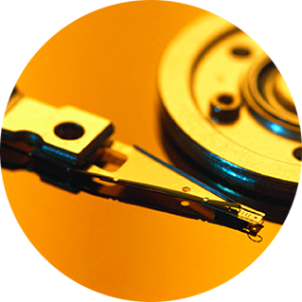
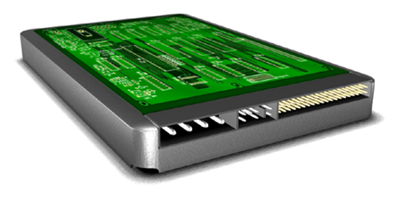
Storage – Hard Disk Drives
Components of HDD
Controller
Board
HDA
Platter and
Read/Write Head
Interface
Power
Connectors
Notes:
A hard disk drive is a persistent storage device that stores and retrieves data using rapidly rotating disks (platters) coated with magnetic material. The key components of a hard disk drive (HDD) are platter, spindle, read-write head, actuator arm assembly, and controller board. I/O operations in an HDD are performed by rapidly moving the arm across the rotating flat platters coated with magnetic material. Data is transferred between the disk controller and magnetic platters through the read-write (R/W) head which is attached to the arm. Data can be recorded and erased on magnetic platters any number of times.
Platter: A typical HDD consists of one or more flat circular disks called platters. The data is recorded on these platters in binary codes (0s and 1s). The set of rotating platters is sealed in a case, called Head Disk Assembly (HDA). A platter is a rigid, round disk coated with magnetic material on both surfaces (top and bottom). The data is encoded by polarizing the magnetic area or domains of the disk surface. Data can be written to or read from both surfaces of the platter. The number of platters and the storage capacity of each platter determine the total capacity of the drive.
Spindle: A spindle connects all the platters and is connected to a motor. The motor of the spindle rotates with a constant speed. The disk platter spins at a speed of several thousands of revolutions per minute (rpm). Common spindle speeds are 5,400 rpm, 7,200 rpm, 10,000 rpm, and 15,000 rpm. The speed of the platter increases with the improvement in technology; although the extent to which it can be improved is limited.
(Cont’d)

Slide 23




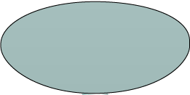





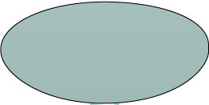








Physical Disk Structure
Spindle
Sector
Sector
Track
Cylinder
Track
Platter
Notes:
Data on the disk is recorded on tracks, which are concentric rings on the platter around the spindle. The tracks are numbered, starting from zero, from the outer edge of the platter. The number of tracks per inch (TPI) on the platter (or the track density) measures how tightly the tracks are packed on a platter.
Each track is divided into smaller units called sectors. A sector is the smallest, individually addressable unit of storage. The track and sector structure is written on the platter by the drive manufacturer using a low-level formatting operation. The number of sectors per track varies according to the drive type. There can be thousands of tracks on a platter, depending on the physical dimensions and the recording density of the platter.
Typically, a sector holds 512 bytes of user data; although some disks can be formatted with larger sector sizes. In addition to user data, a sector also stores other information, such as the sector number, head number or platter number, and track number. This information helps the controller to locate the data on the drive.
A cylinder is a set of identical tracks on both surfaces of each drive platter. The location of R/W heads is referred to by the cylinder number, not by the track number.

Slide 24
Logical Block Addressing
Sector 8
(Upper Surface)
Head 0
Block 0
Cylinder 1
Block 32
(Lower Surface)
Block 64
Block 128
Physical Address = CHS
Logical Block Address = Block #
Notes:
The earlier drives used physical addresses consisting of cylinder, head, and sector (CHS) number to refer to specific locations on the disk, and the OS had to be aware of the geometry of each disk used. Logical block addressing (LBA) has simplified the addressing by using a linear address to access physical blocks of data. The disk controller translates LBA to a CHS address, and the compute system needs to know only the size of the disk drive in terms of the number of blocks. The logical blocks are mapped to physical sectors on a 1:1 basis.
In the slide, the drive shows eight sectors per track, six heads, and four cylinders. This means a total of 8 × 6 × 4 = 192 blocks; so the block number ranges from 0 to 191. Each block has its own unique address.
Assuming that the sector holds 512 bytes, a 500 GB drive with a formatted capacity of 465.7 GB has in excess of 976,000,000 blocks.

Slide 25
HDD Performance
Electromechanical device
Impacts the overall performance of the storage system
Disk service time
Time taken by a disk to complete an I/O request, depends on:
Seek time
Rotational latency
Data transfer rate
Disk service time = seek time + rotational latency + data transfer time
Notes:
A disk drive is an electromechanical device that governs the overall performance of the storage system environment. The various factors that affect the performance of disk drives are:
Seek time
Rotational latency
Data transfer rate

Slide 26
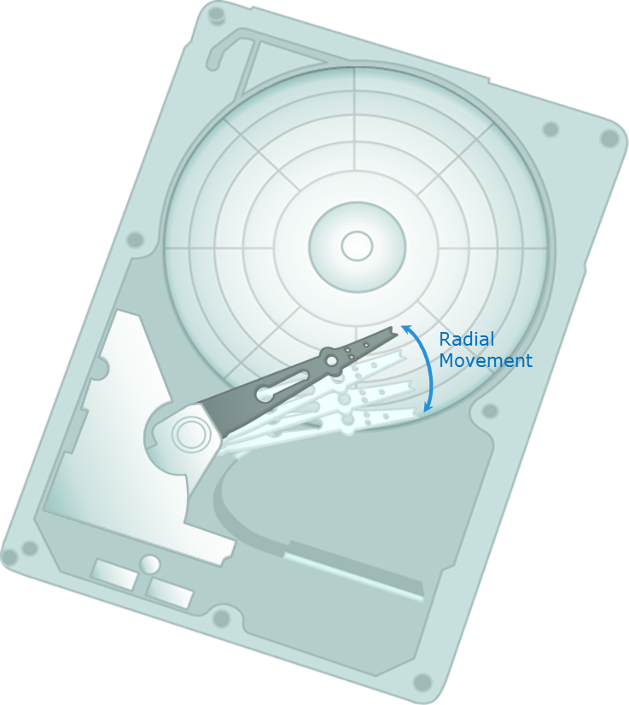
Seek Time
Time taken to position the read/write head
The lower the seek time, the faster the I/O operation
Seek time specifications include
Full stroke
Average
Track-to-track
The seek time of a disk is specified by the drive manufacturer
Notes:
The seek time (also called access time) describes the time taken to position the R/W heads across the platter with a radial movement (moving along the radius of the platter). In other words, it is the time taken to position and settle the arm and the head over the correct track. Therefore, the lower the seek time, the faster the I/O operation. Disk vendors publish the following seek time specifications:
Full Stroke: It is the time taken by the R/W head to move across the entire width of the disk, from the innermost track to the outermost track.
Average: It is the average time taken by the R/W head to move from one random track to another, normally listed as the time for one-third of a full stroke.
Track-to-Track: It is the time taken by the R/W head to move between adjacent tracks.
Each of these specifications is measured in milliseconds (ms). The seek time of a disk is typically specified by the drive manufacturer. The average seek time on a modern disk is typically in the range of 3 to 15 ms. Seek time has more impact on the I/O operation of random tracks rather than the adjacent tracks. To minimize the seek time, data can be written to only a subset of the available cylinders. This results in lower usable capacity than the actual capacity of the drive. For example, a 500 GB disk drive is set up to use only the first 40 percent of the cylinders and is effectively treated as a 200 GB drive. This is known as short-stroking the drive.

Slide 27
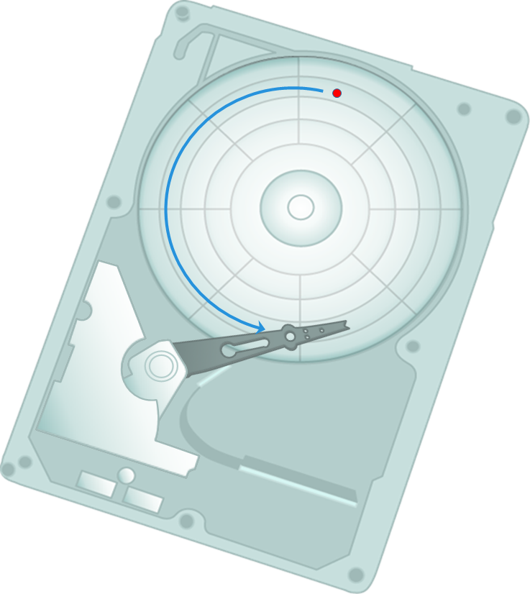
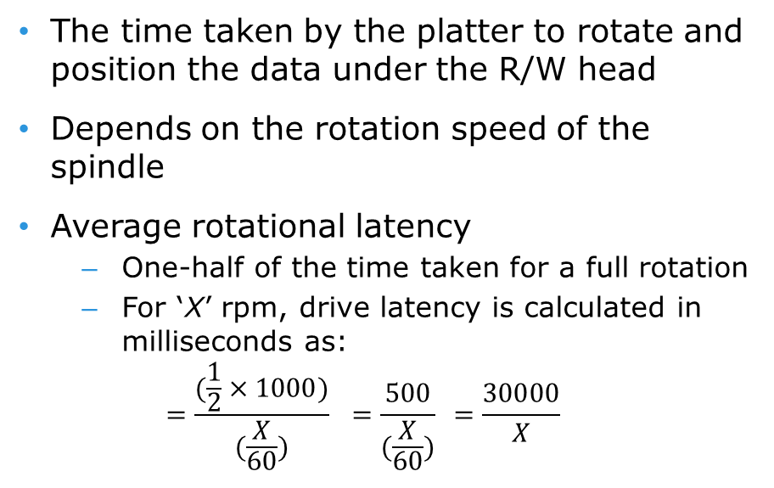
Rotational Latency
The time taken by the platter to rotate and position the data under the R/W head
Depends on the rotation speed of the spindle
Average rotational latency
One-half of the time taken for a full rotation
For ‘X’ rpm, drive latency is calculated in milliseconds as:
$$=\frac{(\frac{1}{2}×1000)}{(\frac{X}{60})} =\frac{500}{(\frac{X}{60})} =\frac{30000}{X}$$
Notes:
To access data, the actuator arm moves the R/W head over the platter to a particular track while the platter spins to position the requested sector under the R/W head. The time taken by the platter to rotate and position the data under the R/W head is called rotational latency. This latency depends on the rotation speed of the spindle and is measured in milliseconds. The average rotational latency is one-half of the time taken for a full rotation. Similar to the seek time, rotational latency has more impact on the reading/writing of random sectors on the disk than on the same operations on adjacent sectors.
Average rotational latency is approximately 5.5 ms for a 5,400-rpm drive, and around 2 ms for a 15,000-rpm drive as shown below.
Average rotational latency for 15K rpm (30000/15000) drive is = $\frac{30000}{15000}=$ 2 ms

Slide 28
Data Transfer Rate
Average amount of data per unit time that the drive can deliver to the HBA
Internal transfer rate: Speed at which data moves from a platter’s surface to the internal buffer of the disk
External transfer rate: Rate at which data move through the interface to the HBA
Disk Drive
HBA
Interface
Head Disk
Assembly
Buffer
External transfer rate measured here
Internal transfer rate measured here
Notes:
The data transfer rate (also called transfer rate) refers to the average amount of data per unit time that the drive can deliver to the HBA. In a read operation, the data first moves from disk platters to R/W heads; then it moves to the drive’s internal buffer. Finally, data moves from the buffer through the interface to the compute system’s HBA. In a write operation, the data moves from the HBA to the internal buffer of the disk drive through the drive’s interface. The data then moves from the buffer to the R/W heads. Finally, it moves from the R/W heads to the platters. The data transfer rates during the R/W operations are measured in terms of internal and external transfer rates, as shown on the slide.
Internal transfer rate is the speed at which data moves from a platter’s surface to the internal buffer (cache) of the disk. The internal transfer rate takes into account factors such as the seek time and rotational latency. External transfer rate is the rate at which data can move through the interface to the HBA. The external transfer rate is generally the advertised speed of the interface, such as 133 MB/s for ATA.

Slide 29
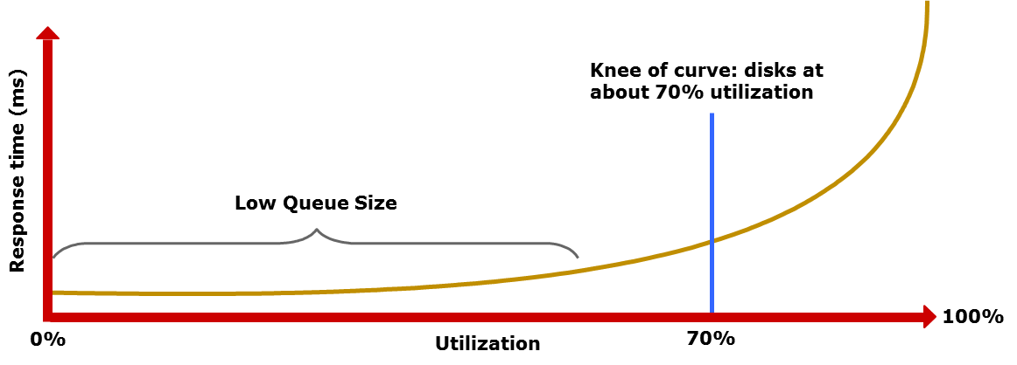
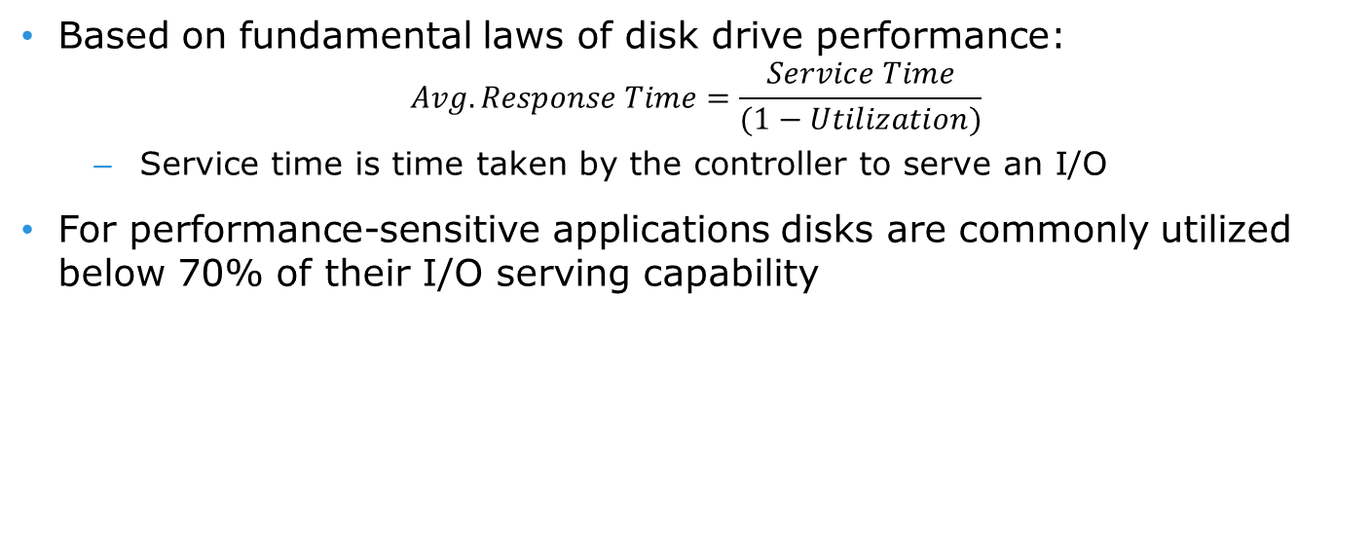
I/O Controller Utilization Vs. Response Time
Based on fundamental laws of disk drive performance:
$$Avg. Response Time=\frac{Service Time}{(1−Utilization)}$$
Service time is time taken by the controller to serve an I/O
For performance-sensitive applications disks are commonly utilized below 70% of their I/O serving capability
Notes:
The utilization of a disk I/O controller has a significant impact on the I/O response time. Consider that a disk is viewed as a black box consisting of two elements: the queue and the disk I/O controller. Queue is the location where an I/O request waits before it is processed by the I/O controller and disk I/O controller processes I/Os waiting in the queue one by one.
The I/O requests arrive at the controller at the rate generated by the application. The I/O arrival rate, the queue length, and the time taken by the I/O controller to process each request determines the I/O response time. If the controller is busy or heavily utilized, the queue size will be large and the response time will be high. Based on the fundamental laws of disk drive performance, the relationship between controller utilization and average response time is given as:
Average response time = Service time/(1 – Utilization)
where, service time is the time taken by the controller to serve an I/O.
As the utilization reaches 100 percent, that is, as the I/O controller saturates, the response time moves closer to infinity. In essence, the saturated component or the bottleneck forces the serialization of I/O requests; meaning, each I/O request must wait for the completion of the I/O requests that preceded it. The figure on the slide shows a graph plotted between utilization and response time. The graph indicates that as the utilization increases, the response time changes are nonlinear. When the average queue sizes are low, the response time remains low. The response time increases slowly with added load on the queue and increases exponentially when the utilization exceeds 70 percent. Therefore, for performance-sensitive applications, it is common to utilize disks below their 70 percent of I/O serving capability.

Slide 30
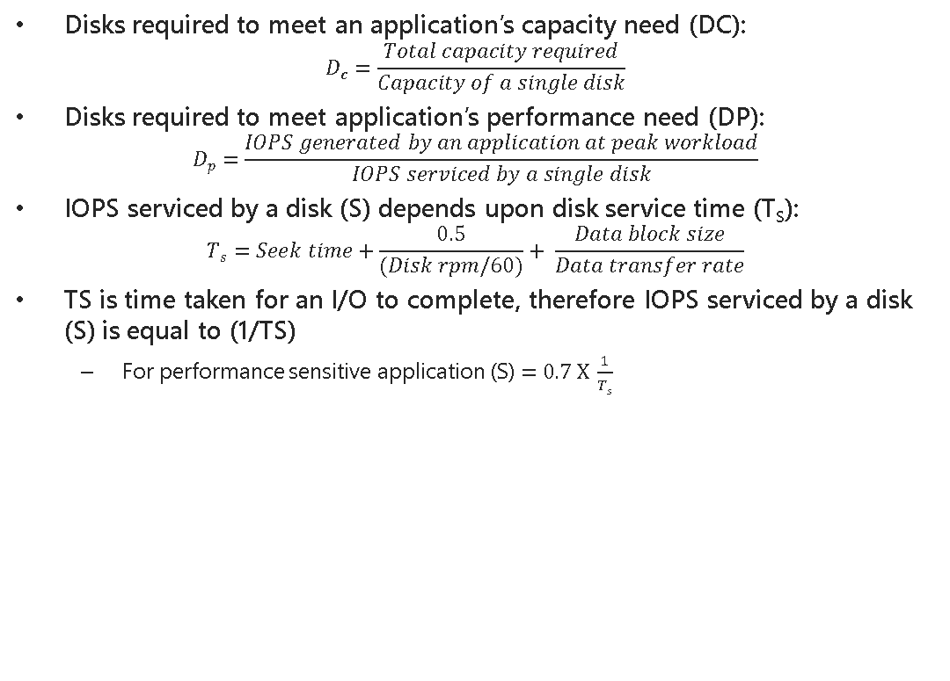
Storage Design Based on Application Requirements and Disk Drive Performance
Disks required to meet an application’s capacity need (DC):
$$Dc=\frac{Total capacity required}{Capacity of a single disk}$$
Disks required to meet application’s performance need (DP):
$$Dp=\frac{IOPS generated by an application at peak workload}{IOPS serviced by a single disk}$$
IOPS serviced by a disk (S) depends upon disk service time (T_{S}):
$$Ts=Seek time+\frac{0.5}{(Disk rpm/60)}+ \frac{Data block size}{Data transfer rate}$$
TS is time taken for an I/O to complete, therefore IOPS serviced by a disk (S) is equal to (1/TS)
For performance sensitive application (S)$=0.7 X \frac{1}{Ts}$
Disk required for an application = Max (DC, DP)
Notes:
Determining storage requirements for an application begins with determining the required storage capacity and I/O performance. Capacity can be easily estimated by the size and number of file systems and database components used by applications. The I/O size, I/O characteristics, and the number of I/Os generated by the application at peak workload are other factors that affect performance, I/O response time and design of storage system.
The disk service time (T_{S}) for an I/O is a key measure of disk performance; T_{S,} along with disk utilization rate (U), determines the I/O response time for an application. As discussed earlier the total disk service time is the sum of the seek time, rotational latency, and transfer time.
Note that transfer time is calculated based on the block size of the I/O and given data transfer rate of a disk drive. For example, for an I/O with a block size of 32 KB and given disk data transfer rate of 40MB/s; the transfer time will be 32 KB/40 MB.
T_{S} determines the time taken by the I/O controller to serve an I/O, therefore, the maximum number of I/Os serviced per second or IOPS is (1/T_{S}).
The IOPS calculated above represents the IOPS that can be achieved at potentially high levels of I/O controller utilization (close to 100 percent). If the application demands a faster response time, then the utilization for the disks should be maintained below 70 percent.
Based on this discussion, the total number of disks required for an application is computed as: Max (Disks required for meeting capacity, Disks required for meeting performance)
(Cont’d)

Slide 31
Components of Intelligent Storage Systems – II
This lesson covers the following topics:
SSD components, addressing, and performance
Notes:
This lesson covers components, addressing, and performance of solid state drives.

Slide 32
Storage – Solid State Drives
Components of SSD
.....
I/O interface
RAM Cache
Flash Memory
Flash Memory
Flash Memory
Flash Memory
......
Drive Controller
....
........
Non-Volatile Memory
Flash Memory
Flash Memory
Controller
Mass Storage
Notes:
Solid state drives (SSDs) are storage devices that contain non-volatile flash memory. Solid state drives are superior to mechanical hard disk drives in terms of performance, power use, and availability. These drives are especially well suited for low-latency applications that require consistent, low (less than 1 ms) read/write response times. In a HDD servicing, small-block, highly-concurrent, random workloads involve considerable rotational and seek latency, which significantly reduces throughput.
Externally solid state drives have the same physical format and connectors as mechanical hard disk drives. This maintains the compatibility in form and format with mechanical hard disk drives, and allows easy replacement of a mechanical drive with a solid state drive. Internally, a solid state drive’s hardware architecture consists of the following components: I/O interface, controller, and mass storage.
The I/O interface enables connecting the power and data connectors to the solid state drives. SSDs typically support standard connectors such as SATA, SAS, or FC.
The controller includes a drive controller, RAM, and non-volatile memory (NVRAM). The drive controller manages all drive functions. The SSDs include many features such as encryption and write coalescing. The non-volatile RAM (NVRAM) is used to store the SSD’s operational software and data. Not all SSDs have separate NVRAM. Some models store their programs and data to the drive’s mass storage. The RAM is used in the management of data being read and written from the SSD as a cache, and for the SSD’s operational programs and data. The portion of the drive’s RAM used for controller cache enhances the overall performance of the SSD. Mass storage, which is made of flash memories, writes slower than it reads. The drive’s RAM is used to minimize the number of writes to mass storage and improve the response time of the drive.
(Cont’d)

Slide 33
SSD Addressing
Logically mapped to pages (SSD metadata)
LBA 0x2000
LBA 0x3000
8KB write to SSD
Saved as two 4KB pages
……
128KB Block
(32 x 4KB pages)
4KB Page
Notes:
Solid state memory chips have different capacities, for example a solid state memory chip can be 32 GB or 4 GB per chip. However, all memory chips share the same logical organization, that is pages and blocks.
At the lowest level, a solid state drive stores bits. Eight bits make up a byte, and while on the typical mechanical hard drive 512 bytes would make up a sector, solid state drives do not have sectors. Solid state drives have a similar physical data object called a page. Like a mechanical hard drive sector, the page is the smallest object that can be read or written on a solid state drive. Unlike mechanical hard drives, pages do not have a standard capacity. A page’s capacity depends on the architecture of the solid state memory chip. Typical page capacities are 4 KB, 8 KB, and 16 KB.
A solid state drive block is made up of pages. A block may have 32, 64, or 128 pages. 32 is a common block size. The total capacity of a block is dependent on the solid state chip’s page size. Only entire blocks may be written or erased on a solid state memory chip. Individual pages may be read or invalidated (a logical function). For a block to be written, pages are assembled into full blocks in the solid state drive’s cache RAM and then written to the block storage object.

Slide 34
Page and Block States
Start
Erased
Write
New
Start
Erased
Write
Valid
Erase
(electrical)
(re)write
or delete
Write
or delete
Erase
(electrical)
Invalid
Used
(re)write
or delete (invalidate page)
Flash memory page states
Block state diagram
Notes:
A page has three possible states, erased (empty), valid, and invalid. In order to write any data to a page, its owning block location on the flash memory chip must be electrically erased. This function is performed by the SSD’s hardware. Once a page has been erased, new data can be written to it. For example, when a 4 KB of data is written to a 4 KB capacity page, the state of that page is changed to valid, as it is holding valid data. A valid page’s data can be read any number of times. If the drive receives a write request to the valid page, the page is marked invalid and that write goes to another page. This is because erasing blocks is time consuming and may increase the response time. Once a page is marked invalid, its data can no longer be read. An invalid page needs to be erased before it can once again be written with new data. Garbage collection handles this process. Garage collection is the process of providing new erased blocks.
A block has three possible states, erased (empty), new, and used. Once a block is erased, a block’s number of pages that have been assembled in the SSD’s RAM may be written to it. For example, thirty two 4 KB pages may be assembled into a block, and then written to the erased block. This sets the block’s state to “new”, meaning it is holding pages with valid data. A block’s valid pages can be read any number of times. There are two mechanisms to invalidate a page, writes and deletes. If the drive receives a write request to a valid block page, the page must be changed. The current page containing the destination of the write is marked invalid. The block’s state changes to “used”, because it contains invalid pages. These writes go to another page, on an erased block. A delete invalidates a page without resulting in a subsequent write.

Slide 35
SSD Performance
Access type
SSD performs random reads the best
SSDs use all internal I/O channels in parallel for multi-threaded large block I/Os
Drive state
New SSD or SSD with substantial unused capacity offers best performance
Workload duration
SSDs are best for workloads with short bursts of activity
Notes:
Solid state drives are semiconductor, random-access devices; these result in very low response times compared to hard disk drives. This, combined with the multiple parallel I/O channels on the back end, gives SSDs performance characteristics that are better than HDDs.
SSD performance is dependent on access type, drive state, and workload duration. SSD performs random reads the best. In carefully tuned multi-threaded, small-block random I/O workload storage environments, SSDs can deliver much lower response times and higher throughput than HDDs. This is because random-read I/Os cannot usually be serviced by read-ahead algorithms on a HDD or by read cache on the storage system. The latency of a random read operation is directly related to the seek time of a HDD. For HDDs, this is the physical movement of the drive’s read/write head to access the desired area. Because they are random access devices, SSDs pay no penalty for retrieving I/O that is stored in more than one area; as a result their response time is in an order of magnitude faster than the response time of HDDs.
For large block I/Os, SSDs tend to use all internal I/O channels in parallel. Since the single-threaded sequential I/O streams on FC HDDs do not suffer seek and rotational latencies (because of the storage system cache), single-threaded large-block sequential I/O streams will not show major performance improvements with SSDs over FC HDDs. However, with the increased application concurrency (as more threads are added), the load starts to resemble a large block-random workload. In this case, seek and rotational latencies are introduced that decrease the FC HDD effectiveness but do not decrease SSD effectiveness.
A new SSD or an SSD with substantial unused capacity has the best performance. Drives with substantial amounts of their capacity consumed will take longer to complete the read-modify-write cycle. SSDs are best for workloads with short bursts of activity.

Slide 36
Part 4: RAID
This lesson covers the following topics:
Describe RAID implementation methods
Describe the three RAID techniques
Describe commonly used RAID levels
Describe the impact of RAID on performance
Compare RAID levels based on their cost, performance, and protection
Notes:
This lesson covers RAID and its use to improve performance and protection. It covers various RAID implementations, techniques, and levels commonly used. This lesson also covers the impact of RAID on performance and compares the commonly used RAID levels.

Slide 37
Why RAID?
RAID
A technique that combines multiple disk drives into a logical unit (RAID set) and provides protection, performance, or both.
Provides data protection against drive failures
Improves storage system performance by serving I/Os from multiple drives simultaneously
Two implementation methods
Software RAID implementation
Hardware RAID implementation
Notes:
Redundant Array of Independent Disks (RAID) is a technique in which multiple disk drives are combined into a logical unit called a RAID set and data is written in blocks across the disks in the RAID set. RAID protects against data loss when a drive fails, through the use of redundant drives and parity. RAID also helps in improving the storage system performance as read and write operations are served simultaneously from multiple disk drives.
RAID is typically implemented by using a specialized hardware controller present either on the compute system or on the storage system. The key functions of a RAID controller are management and control of drive aggregations, translation of I/O requests between logical and physical drives, and data regeneration in the event of drive failures.
(Cont’d)

Slide 38
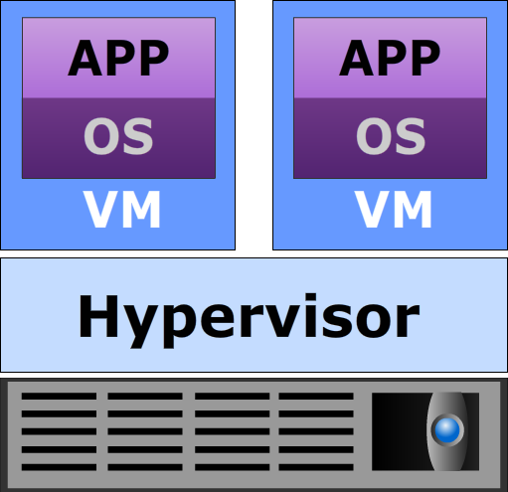

RAID Array Components
Logical Array
(RAID Sets)
RAID Controller
Hard Disks
Compute System
RAID Array
Notes:
A RAID array is an enclosure that contains a number of disk drives and supporting hardware to implement RAID. A subset of disks within a RAID array can be grouped to form logical associations called logical arrays, also known as a RAID set or a RAID group.

Slide 39
RAID Techniques
Striping
Mirroring
Parity
A
A
A
RAID Controller
RAID Controller
RAID Controller
D1
D2
D3
P
A1
A2
A3
A4
A
A
A1
A2
A3
Ap
Strip
Rebuilding data of the failed D3 drive:
D1 + D2 + ? = P
D3 = P – D1 – D2
Stripe
Figure 1
Figure 2
Figure 3
Notes:
The three different RAID techniques that form the basis for defining various RAID levels are striping, mirroring, and parity. These techniques determine the data availability and performance of a RAID set as well as the relative cost of deploying a RAID level.
Striping is a technique of spreading data across multiple drives (more than one) in order to use the drives in parallel. All the read-write heads work simultaneously, allowing more data to be processed in a shorter time and increasing performance, compared to reading and writing from a single disk. Within each disk in a RAID set, a predefined number of contiguously addressable disk blocks are defined as strip. The set of aligned strips that spans across all the disks within the RAID set is called a stripe. The figure 1 on the slide shows representations of a striped RAID set. Strip size (also called stripe depth) describes the number of blocks in a strip (represented as “A1, A2, A3, and A4”), and is the maximum amount of data that can be written to or read from a single disk in the set, assuming that the accessed data starts at the beginning of the strip. All strips in a stripe have the same number of blocks. Having a smaller strip size means that the data is broken into smaller pieces while it is spread across the disks. Stripe size (represented as A) is a multiple of strip size by the number of data disks in the RAID set. For example, in a four disk striped RAID set with a strip size of 64KB, the stripe size is 256 KB (64KB x 4). In other words, A = A1 +A2 + A3 + A4. Stripe width refers to the number of data strips in a stripe. Striped RAID does not provide any data protection unless parity or mirroring is used.
(Cont’d)

Slide 40
RAID Levels
Commonly used RAID levels are:
RAID 0 – Striped set with no fault tolerance
RAID 1 – Disk mirroring
RAID 1 + 0 – Nested RAID
RAID 3 – Striped set with parallel access and dedicated parity disk
RAID 5 – Striped set with independent disk access and a distributed parity
RAID 6 – Striped set with independent disk access and dual distributed parity
Notes:
The RAID level selection depends on the parameters such as application performance, data availability requirements, and cost. These RAID levels are defined on the basis of striping, mirroring, and parity techniques. Some RAID levels use a single technique, whereas others use a combination of techniques. The commonly used RAID levels are listed on the slide.

Slide 41
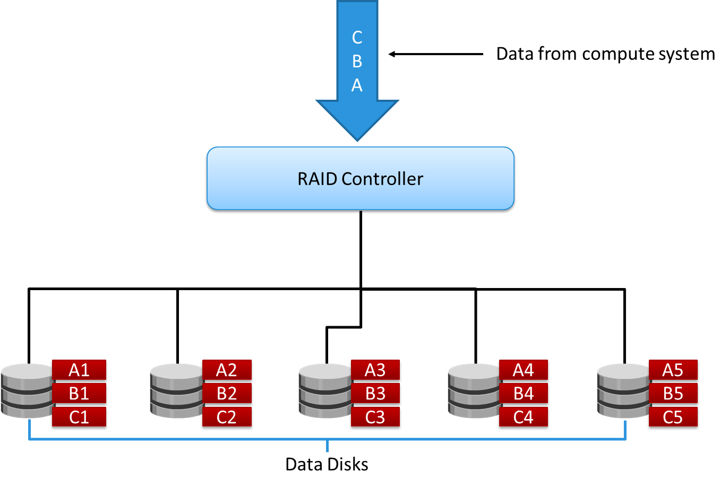
RAID 0
Notes:
RAID 0 configuration uses data striping techniques, where data is striped across all the disks within a RAID set. Therefore it utilizes the full storage capacity of a RAID set. To read data, all the strips are gathered by the controller. When the number of drives in the RAID set increases, the performance improves because more data can be read or written simultaneously. RAID 0 is a good option for applications that need high I/O throughput. However, if these applications require high availability during drive failures, RAID 0 does not provide data protection and availability.

Slide 42
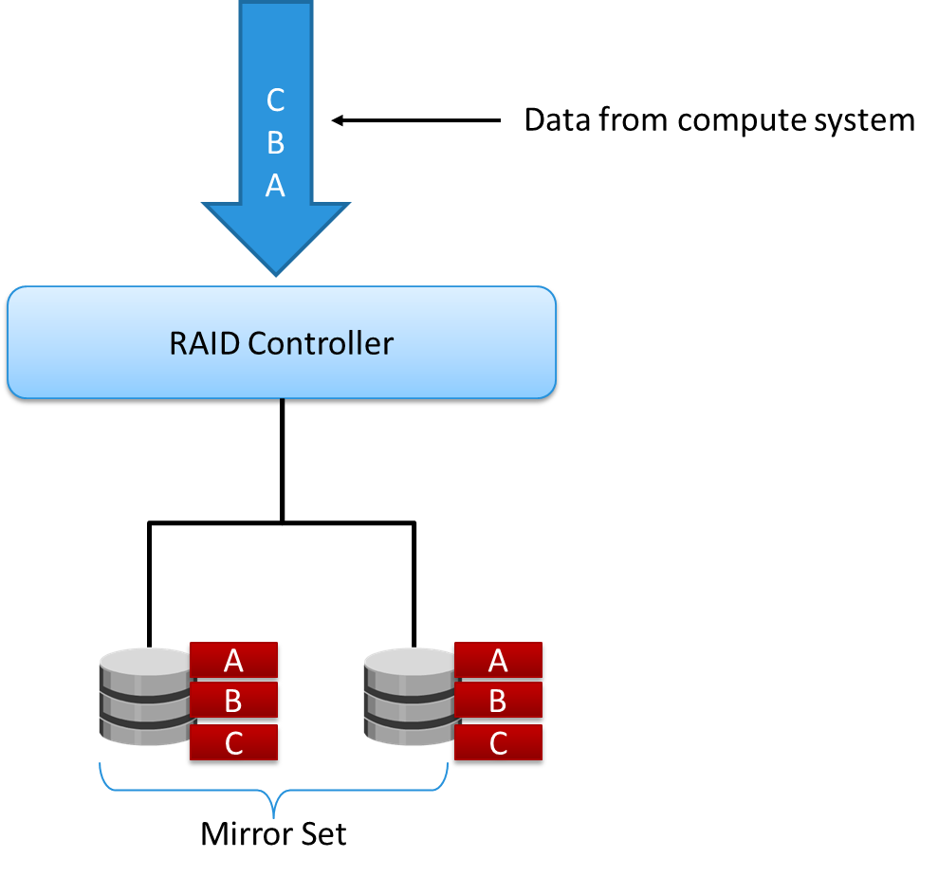
RAID 1
Notes:
RAID 1 is based on the mirroring technique. In this RAID configuration, data is mirrored to provide fault tolerance. A RAID 1 set consists of two disk drives and every write is written to both disks. The mirroring is transparent to the compute system. During disk failure, the impact on data recovery in RAID 1 is the least among all RAID implementations. This is because the RAID controller uses the mirror drive for data recovery. RAID 1 is suitable for applications that require high availability and cost is not a constraint.

Slide 43
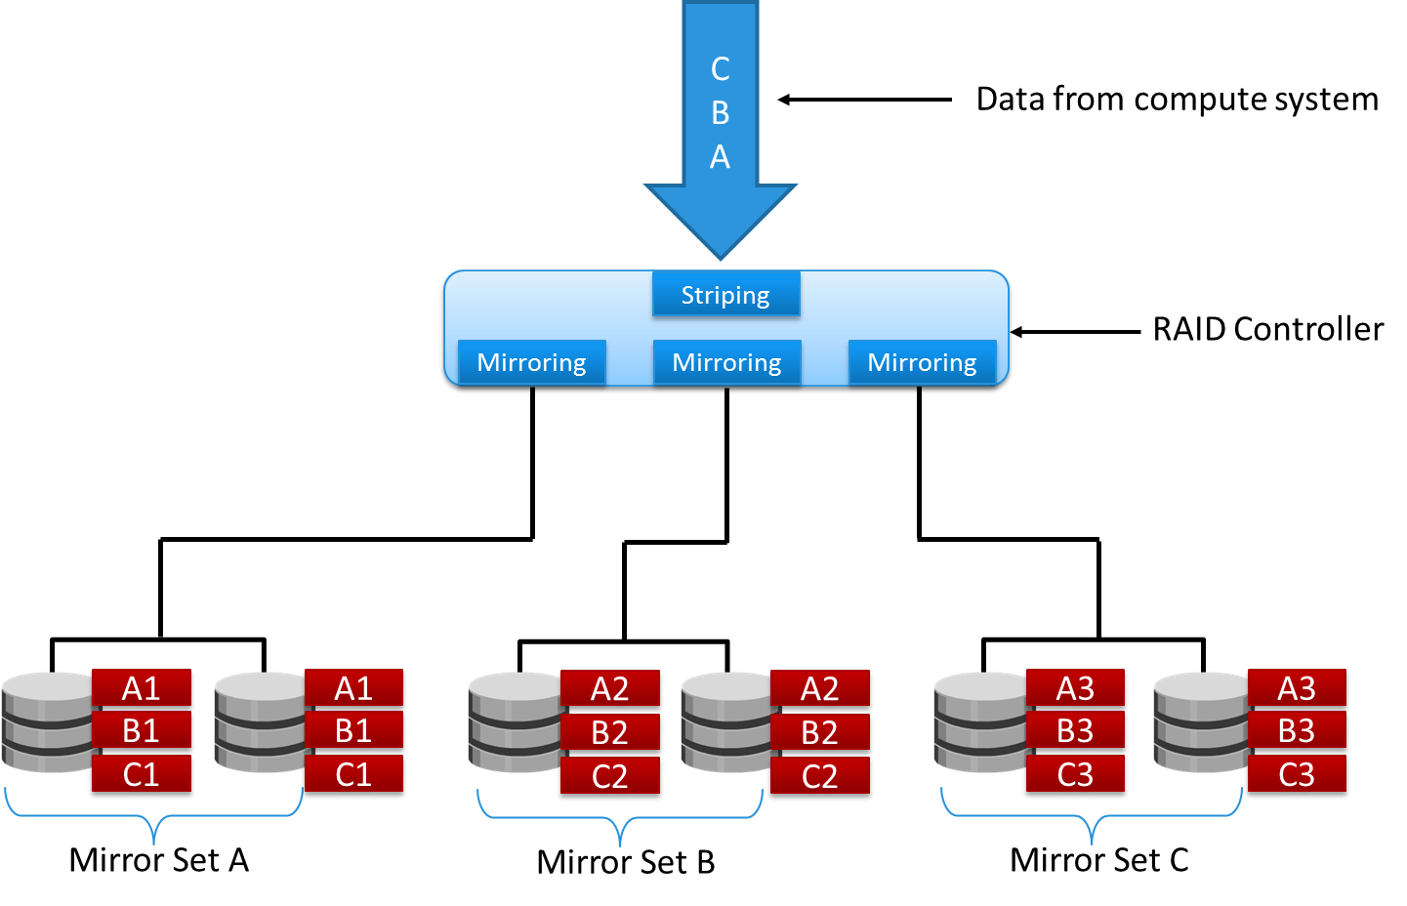
Nested RAID – 1+0
Notes:
Most data centers require data redundancy and performance from their RAID arrays. RAID 1+0 combines the performance benefits of RAID 0 with the redundancy benefits of RAID 1. It uses mirroring and striping techniques and combines their benefits. This RAID type requires an even number of disks, the minimum being four.
RAID 1+0 is also known as RAID 10 (Ten) or RAID 1/0. RAID 1+0 is also called striped mirror. The basic element of RAID 1+0 is a mirrored pair, which means that data is first mirrored and then both copies of the data are striped across multiple disk drive pairs in a RAID set. When replacing a failed drive, only the mirror is rebuilt. In other words, the storage system controller uses the surviving drive in the mirrored pair for data recovery and continuous operation. Data from the surviving disk is copied to the replacement disk.

Slide 44
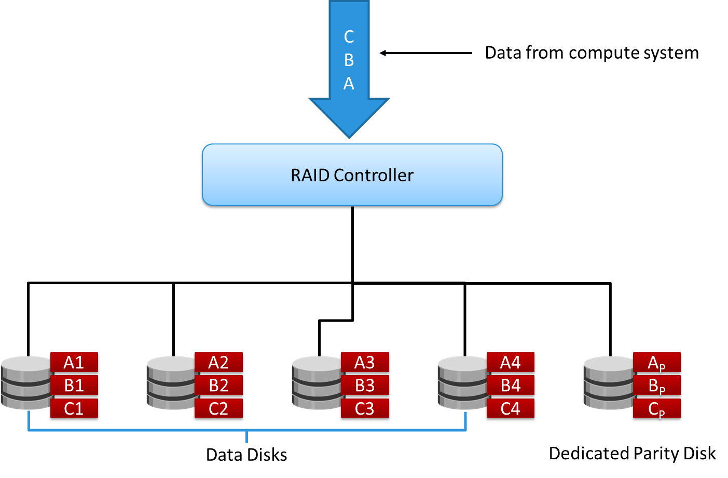
RAID 3
Notes:
RAID 3 stripes data for performance and uses parity for fault tolerance. Parity information is stored on a dedicated drive so that the data can be reconstructed if a drive fails in a RAID set. For example, in a set of five disks, four are used for data and one for parity. Therefore, the total disk space required is 1.25 times the size of the data disks. RAID 3 always reads and writes complete stripes of data across all disks because the drives operate in parallel. There are no partial writes that update one out of many strips in a stripe.

Slide 45
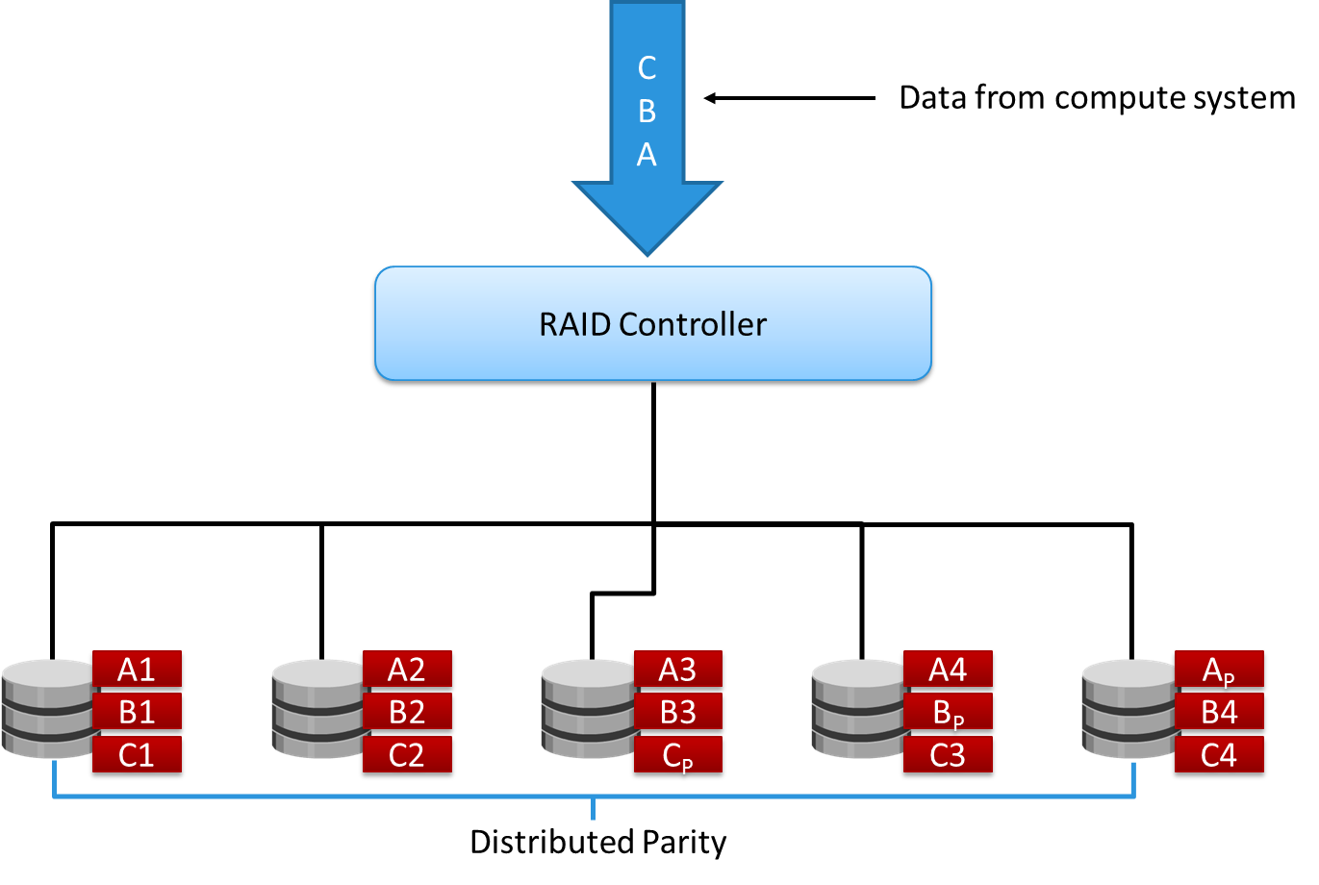
RAID 5
Notes:
RAID 5 is a versatile RAID implementation. It is similar to RAID 4 because it uses striping. The drives (strips) are also independently accessible. The difference between RAID 4 and RAID 5 is the parity location. In RAID 4, parity is written to a dedicated drive, creating a write bottleneck for the parity disk. In RAID 5, parity is distributed across all disks to overcome the write bottleneck of a dedicated parity disk.

Slide 46

RAID 6
Notes:
RAID 6 works the same way as RAID 5, except that RAID 6 includes a second parity element to enable survival if two disk failures occur in a RAID set. Therefore, a RAID 6 implementation requires at least four disks. RAID 6 distributes the parity across all the disks. The write penalty (explained later in this module) in RAID 6 is more than that in RAID 5; therefore, RAID 5 writes perform better than RAID 6. The rebuild operation in RAID 6 may take longer than that in RAID 5 due to the presence of two parity sets.

Slide 47
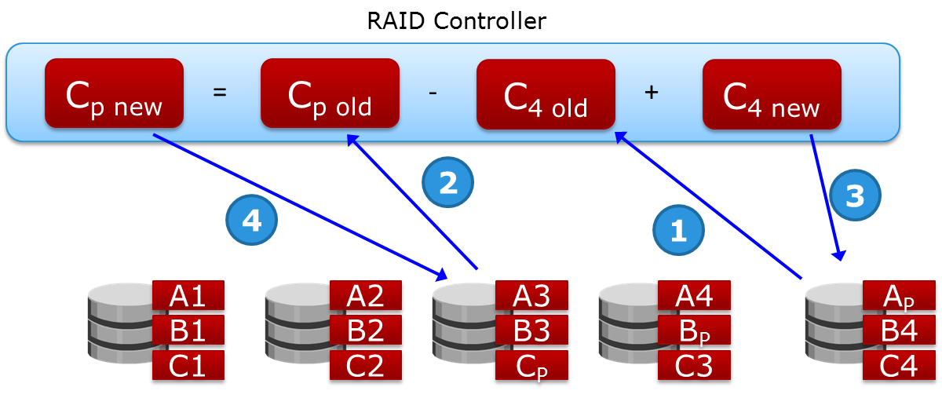
RAID Impacts on Performance
In RAID 5, every write (update) to a disk manifests as four I/O operations (2 disk reads and 2 disk writes)
In RAID 6, every write (update) to a disk manifests as six I/O operations (3 disk reads and 3 disk writes)
In RAID 1, every write manifests as two I/O operations (2 disk writes)
Notes:
When choosing a RAID type, it is imperative to consider its impact on disk performance and application IOPS. In both mirrored and parity RAID configurations, every write operation translates into more I/O overhead for the disks, which is referred to as a write penalty. In a RAID 1 implementation, every write operation must be performed on two disks configured as a mirrored pair, whereas in a RAID 5 implementation, a write operation may manifest as four I/O operations. When performing I/Os to a disk configured with RAID 5, the controller has to read, recalculate, and write a parity segment for every data write operation.
This slide illustrates a single write operation on RAID 5 that contains a group of five disks. The parity (P) at the controller is calculated as follows:
C_{p} = C₁ + C₂ + C₃ + C₄ (XOR operations)
Whenever the controller performs a write I/O, parity must be computed by reading the old parity (C_{p} old) and the old data (C_{4 old}) from the disk, which means two read I/Os. Then, the new parity (C_{p} new) is computed as follows:
C_{p new} = C_{p old} – C_{4 old} + C_{4 new} (XOR operations)
After computing the new parity, the controller completes the write I/O by writing the new data and the new parity onto the disks, amounting to two write I/Os. Therefore, the controller performs two disk reads and two disk writes for every write operation, and the write penalty is 4.
In RAID 6, which maintains dual parity, a disk write requires three read operations: two parity and one data. After calculating both the new parities, the controller performs three write operations: two parity and an I/O. Therefore, in a RAID 6 implementation, the controller performs six I/O operations for each write I/O, and the write penalty is 6.

Slide 48
RAID Comparison
RAID level | Min disks | Available storage capacity (%) | Write penalty | Protection
1 | 2 | 50 | 2 | Mirror
1+0 | 4 | 50 | 2 | Mirror
3 | 3 | [(n-1)/n]*100 | 4 | Parity (Supports single disk failure)
5 | 3 | [(n-1)/n]*100 | 4 | Parity (Supports single disk failure)
6 | 4 | [(n-2)/n]*100 | 6 | Parity (Supports two disk failures)
Notes:
The table on the slide compares different RAID levels.

Slide 49
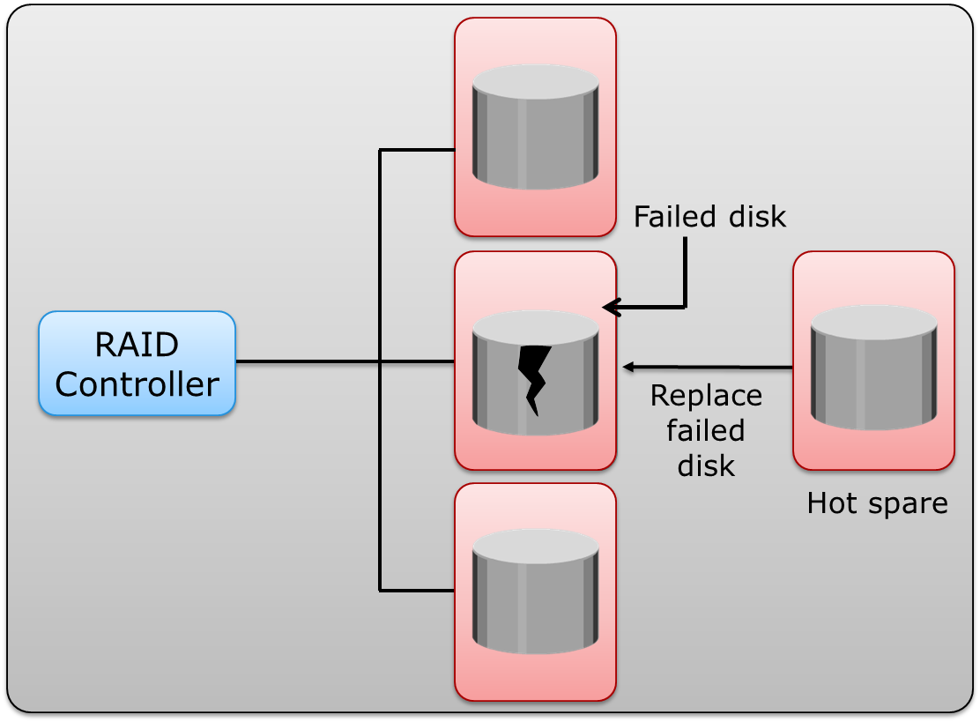
Dynamic Disk Sparing (Hot Sparing)
Notes:
A hot sparing refers to a process that temporarily replaces a failed disk drive with a spare drive in a RAID array by taking the identity of the failed disk drive. With the hot spare, one of the following methods of data recovery is performed depending on the RAID implementation:
If parity RAID is used, the data is rebuilt onto the hot spare from the parity and the data on the surviving disk drives in the RAID set.
If mirroring is used, the data from the surviving mirror is used to copy the data onto the hot spare.
When a new disk drive is added to the system, data from the hot spare is copied to it. The hot spare returns to its idle state, ready to replace the next failed drive. Alternatively, the hot spare replaces the failed disk drive permanently. This means that it is no longer a hot spare, and a new hot spare must be configured on the storage system.
A hot spare should be large enough to accommodate data from a failed drive. Some systems implement multiple hot spares to improve data availability.
A hot spare can be configured as automatic or user initiated, which specifies how it will be used in the event of disk failure. In an automatic configuration, when the recoverable error rates for a disk exceed a predetermined threshold, the disk subsystem tries to copy data from the failing disk to the hot spare automatically. If this task is completed before the damaged disk fails, the subsystem switches to the hot spare and marks the failing disk as unusable. Otherwise, it uses parity or the mirrored disk to recover the data. In the case of a user-initiated configuration, the administrator has control of the rebuild process. For example, the rebuild could occur overnight to prevent any degradation of system performance. However, the system is at risk of data loss if another disk failure occurs.

Slide 50
Part 5: Types of Intelligent Storage Systems
This lesson covers the following topics:
Data access methods
Types of intelligent storage systems
Scale-up and scale-out architectures
Notes:
This lesson covers different types of data access methods. It also covers types of intelligent storage systems. Finally, this lesson covers the scale-up and scale-out architectures.

Slide 51

Data Access Methods
Compute
Compute
Compute
Application
Application
Application
File System
File Interface
User Component
Block Interface
OSD Interface
Storage
Network
File-level Request
Storage
Network
Block-level Request
Storage
Network
Object-level Request
Network
File System
Storage Component
Block I/O
Block I/O
Block I/O
File System
Storage
Storage
Storage
User Component
Storage System
Storage System
Storage System
Storage Component
Block-level Access
Object-level Access
File-level Access
Notes:
Data is accessed and stored by applications using the underlying infrastructure. The key components of this infrastructure are the OS (or file system), connectivity, and storage. The compute system controller card accesses the storage devices using predefined protocols, such as IDE/ATA, SCSI, or Fibre Channel (FC). IDE/ATA and SCSI are popularly used in small and personal computing environments for accessing internal storage. FC and iSCSI protocols are used for accessing data from an external storage device (or subsystems). External storage devices can be connected to the compute system directly or through the storage network. When the storage is connected directly to the compute system, it is referred as Direct-Attached Storage (DAS).
Data can be accessed over a network in one of the following ways: block level, file level, or object level. In general, the application requests data from the file system (or operating system) by specifying the filename and location. The file system has two components: user component and storage component. The user component of the file system performs functions such as hierarchy management, naming, and user access control. The storage component maps the files to the physical location on the storage device. The file system maps the file attributes to the logical block address of the data and sends the request to the storage device. The storage device converts the logical block address (LBA) to a cylinder-head-sector (CHS) address and fetches the data.
In a block-level access, the file system is created on a compute system, and data is accessed on a network at the block level. In this case, raw disks or logical volumes are assigned to the compute system for creating the file system.
In a file-level access, the file system is created on a separate file server or at the storage side, and the file-level request is sent over a network. Because data is accessed at the file level, this method has higher overhead, as compared to the data accessed at the block level.
Object-level access is an intelligent evolution, whereby data is accessed over a network in terms of self-contained objects with a unique object identifier. In this type of access, the file system’s user component resides on the compute system and the storage component resides on the storage system.

Slide 52
Types of Intelligent Storage Systems
Block-based storage systems
File-based storage systems
Object-based storage systems
Unified storage systems
Notes:
Based on the type of data access, a storage system can be classified as block-based storage system, file-based storage system, object-based storage system, and unified storage system. A unified storage system provides block-based, file-based, and object-based data access in a single system.
Details on block-based, file-based, object-based, and unified storage systems are covered in the following modules.

Slide 53
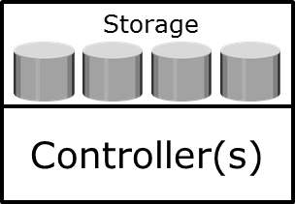
Scale-up Vs. Scale-out Architecture
Storage
Scale-up
Controller(s)
Scale-out
Node 1
Node 2
Node 3
…
Cluster
Notes:
An intelligent storage system may be built either based on scale-up or scale-out architecture.
A scale-up storage architecture provides the capability to scale the capacity and performance of a single storage system based on requirements. Scaling up a storage system involves upgrading or adding controllers and storage. These systems have a fixed capacity ceiling, which limits their scalability and the performance also starts degrading when reaching the capacity limit.
A scale-out storage architecture provides the capability to maximize its capacity by simply adding nodes to the cluster. Nodes can be added quickly to the cluster, when more performance and capacity is needed, without causing any downtime. This provides the flexibility to use many nodes of moderate performance and availability characteristics to produce a total system that has better aggregate performance and availability. Scale-out architecture pools the resources in the cluster and distributes the workload across all the nodes. This results in linear performance improvements as more nodes are added to the cluster.

